Slide 1
XML

Slide 2
Communication Incompatibilities
Problems with data exchange
Application-related
Technology-related

Slide 3
Problem
How do we communicate with each other?
I understand only english
I understand only Hindi

Slide 4
Solution
Approach 1: A translator would translate for us
Approach 2: Think about a common language(CL) that both the persons should learn.

Slide 5
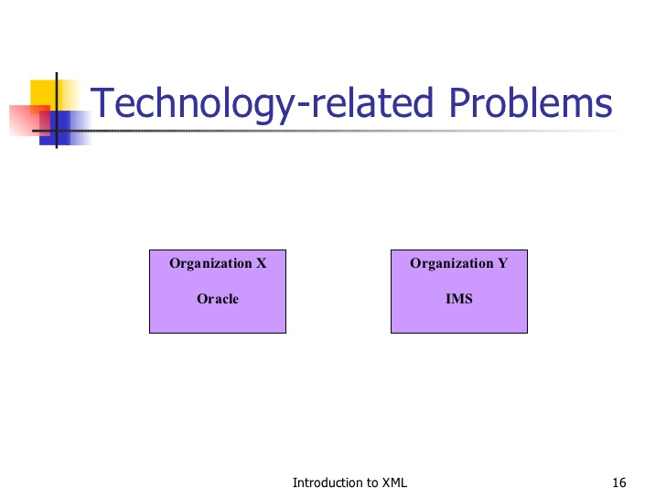
Analyze two approaches

Slide 6
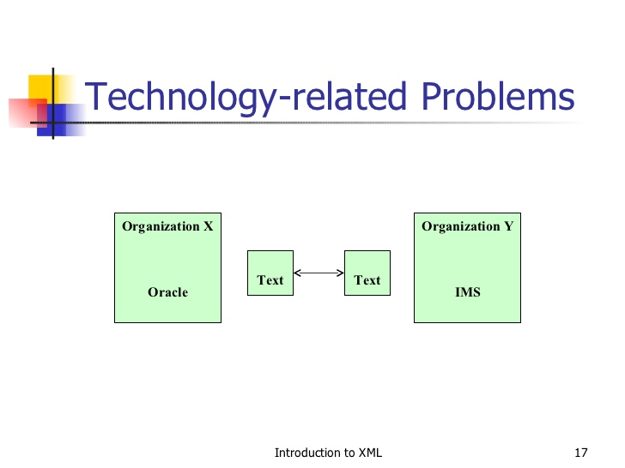

Slide 7
XML
Extensible: User-defined tags and functionality is also user defined. So extensible
Markup: enclosing textual information between opening and closing tags
Language: communicator b2n client and server application.

Slide 8
XML is a meta markup language for text documents / textual data
XML is platform independent and language independent language understandable by all languages.
XML is called meta language because it can create other markup languages.

Slide 9
HTML vs XML
HTML
XML
Predefined tags
Functionality limited
Case-insensitive
Display the data
User-defined tags
Functionality extensible
Case sensitive
Describe the data

Slide 10
1. XML Standards by the W3C
2. XML Documents
3. Namespaces

Slide 11
XML document contains
Element
Attributes
Entity reference

Slide 12
What is XML?
XML stands for EXtensible Markup Language
XML is a markup language much like HTML
XML was designed to describe data, not to display data .
XML tags are not predefined. You must define your own tags .
XML is designed to be self-descriptive

Slide 13
The Difference Between XML and HTML
XML is not a replacement for HTML. XML is a complement to HTML.
XML and HTML were designed with different goals:
XML was designed to describe data, with focus on what data is
HTML was designed to display data, with focus on how data looks
HTML is about displaying information, while XML is about carrying information.

Slide 14
How Can XML be Used?
XML is used in many aspects of web development,
often to simplify data storage and sharing.

Slide 15
XML element
First line is the version and character set used:
<?xml version="1.0" encoding="ISO-8859-1"?>
<note> <to>Tove</to> <from>Jani</from> <heading>Reminder</heading> <body>Don't forget me this weekend!</body> </note>

Slide 16
<employee>
<empno>101</empno>
<name>ram</name>
</employee>
Here we have 3 elements.

Slide 17
XML tree
<root> <child> <subchild>.....</subchild> </child> </root>

Slide 18
XML Tags are Case Sensitive
Message>This is incorrect</message> <message>This is correct</message>

Slide 19
Example:
Take a look at this small inventory list for a store.
Inventory Bikes 24-inch Boys Mountain Bike $200 24-inch Boys Cruiser Bike $150
Skateboards Acme Sportsmen Skateboard $75 Deluxe Boys Skateboard $35

Slide 20
XML code
Version
<?xml version= "1.0"?>
Create a Root Element
<?xml version= "1.0"?> <inventory> </inventory>

Slide 21
Establish the Child Elements
Child elements nest inside the root element. In an inventory listing, you might create sections for different inventory categories.
In the example, we have bikes and skateboards.
<?xml version= "1.0"?> <inventory> <bikes> </bikes> <skateboards> </skateboards> </inventory>

Slide 22
Add Subchild Elements to Hold the Data
<?xml version= "1.0"?> <inventory> <bikes> <model>24-inch Boys Mountain Bike <price>$200.00 </price> </model> <model>24-inch Boys Cruiser Bike <price>$150.00 </price> </model> </bikes> <skateboards> <model> Acme Sportsmen Skateboard <price>$75.00 </price> </model> <model> Deluxe Boys Skateboard <price>$35.00</price> </model> </skateboards> </inventory>

Slide 23
This is just one way to work the XML code for this file. Another method would involve using attributes with the elements to identify each section. The advantage of attributes comes when you create formatting for the XML code. In next article we will create the same file, but use attributes with the elements.

Slide 24
<?xml version= "1.0"?> <inventory id= "toys"> <bikes sex= "boy"> <style id= "mountain" level= "high" size= "24"> <model>24-inch Boys Mountain Bike <price>$200.00 </price> </model> </style> <style id= "cruiser" level= "mid" size= "24"> <model>24-inch Boys Cruiser Bike <price>$150.00 </price> </model> </style> </bike> </inventory>

Slide 25
XML & CSS
<?xml version="1.0"?>
<?xml-stylesheet type= "text/css" href= "sample.css"?>
<sample>
<mymessage>
By adding a style sheet reference, you can format and display your XML code as a web page.
</mymessage>
</sample>

Slide 26
sample.css
sample
{
background-color: #ffffff;
width: 100%;
}
mymessage
{
display: block;
background-color: #999999;
margin-bottom: 30pt;
} /* CSS Document */

Slide 27
SAX & DOM Parser
DOM Stands for Document Object Model and it represent an XML Document into tree format which each element representing tree branches. DOM Parser creates an In Memory tree representation of XML file and then parses it, so it requires more memory and its advisable to have increased heap size for DOM parser

Slide 28
Parsing XML file using DOM parser is quite fast if XML file is small but if you try to read a large XML file using DOM parser there is more chances that it will take a long time or even may not be able to load it completely simply because it requires lot of memory to create XML Dom Tree. Java provides support DOM Parsing and you can parse XML files in Java using DOM parser.

Slide 29
SAX XML Parser
SAX Stands for Simple API for XML Parsing.
This is an event based XML Parsing and it parse XML file step by step so much suitable for large XML Files. SAX XML Parser fires event when it encountered opening tag, element or attribute and the parsing works accordingly.
It’s recommended to use SAX XML parser for parsing large xml files in Java because it doesn't require to load whole XML file in Java and it can read a big XML file in small parts.
Java provides support for SAX parser and you can parse any xml file in Java using SAX Parser, I have covered example of reading xml file using SAX Parser here.
One disadvantage of using SAX Parser in java is that reading XML file in Java using SAX Parser requires more code in comparison of DOM Parser.

Slide 30
Difference between DOM and SAX XML Parser
Here are few high level differences between DOM parser and SAX Parser in Java:
1) DOM parser loads whole xml document in memory while SAX only loads small part of XML file in memory.
2) DOM parser is faster than SAX because it access whole XML document in memory.
3) SAX parser in Java is better suitable for large XML file than DOM Parser because it doesn't require much memory.
4) DOM parser works on Document Object Model while SAX is an event based xml parser.

Slide 31
XML DTD
What is a DTD?
A DTD is a Document Type Definition.
A DTD defines the structure and the legal elements and attributes of an XML document.

Slide 32
Types
Two types
Internal
external

Slide 33
Internal DTD(note.xml)
<?xml version="1.0"?> <!DOCTYPE note [ <!ELEMENT note (to,from,heading,body)> <!ELEMENT to (#PCDATA)> <!ELEMENT from (#PCDATA)> <!ELEMENT heading (#PCDATA)> <!ELEMENT body (#PCDATA)> ]> <note> <to>Tove</to> <from>Jani</from> <heading>Reminder</heading> <body>Don't forget me this weekend</body> </note>

Slide 34
An External DTD Declaration(note.dtd)
<!ELEMENT note (to,from,heading,body)> <!ELEMENT to (#PCDATA)> <!ELEMENT from (#PCDATA)> <!ELEMENT heading (#PCDATA)> <!ELEMENT body (#PCDATA)>

Slide 35
Xml file
<?xml version="1.0"?> <!DOCTYPE note SYSTEM "note.dtd"> <note> <to>Tove</to> <from>Jani</from> <heading>Reminder</heading> <body>Don't forget me this weekend!</body> </note>

Slide 36
XSLT
XSL (eXtensible Stylesheet Language) is a styling language for XML.
XSLT stands for XSL Transformations.
This tutorial will teach you how to use XSLT to transform XML documents into other formats (like transforming XML into HTML).

Slide 37
Xml file
<?xml-stylesheet type="text/xsl“ href="sheet.xsl"?>
<employee>
<name>ram</name>
<age>33</age>
</employee>

Slide 38
Convert it to html(sheet.xsl)
<xsl:stylesheet xmlns:xsl="http://www.w3.org/1999/XSL/Transform" version="1.0">
<xsl:output method="html"/>
<xsl:template match="employee">
<html>
<head>
<title>newstylesheet.xsl</title>
</head>
<body>
<xsl:value-of select = "name"/>
</body>
</html>
</xsl:template>
</xsl:stylesheet>

Slide 39
XSLT-Example 2 XML file
<?xml-stylesheet type="text/xsl" href="sheet1.xsl"?>
<employee>
<emp>
<name>ram</name>
<age>33</age>
</emp>
<emp>
<name>rohit</name>
<age>37</age>
</emp>
</employee>

Slide 40
Display the xml in html table
<xsl:stylesheet xmlns:xsl="http://www.w3.org/1999/XSL/Transform"
version="1.0">
<xsl:output method="html"/>
<xsl:template match="/">
<html>
<head>
<title>newstylesheet.xsl</title>
</head>
<body>
<table border="2" width="50%">
<xsl:for-each select="employee/emp">
<tr>
<td><xsl:value-of select="name"/></td>
<td><xsl:value-of select="age"/></td>
</tr>
</xsl:for-each>
</table>
</body>
</html>
</xsl:template>
</xsl:stylesheet>

Slide 41
Sorting In XSLT xml file
<?xml version="1.0"?>
<?xml-stylesheet type="text/xsl" href="h1.xsl"?>
<college>
<student>
<name>XYZ</name>
<roll>12</roll>
</student>
<student>
<name>ani</name>
<roll>14</roll>
</student>
</college>

Slide 42
h1.xsl
<xsl:stylesheet xmlns:xsl="http://www.w3.org/1999/XSL/Transform" version="1.0">
<xsl:output method="html"/>
<xsl:template match="/">
<html>
<head>
<title>table.xsl</title>
</head>
<body>
<table border="2">
<tr>
<th>name</th>
<th>roll</th>
</tr>
<xsl:for-each select="college/student">
<xsl:sort select="name"/>
<tr>
<td><xsl:value-of select="name"/></td>
<td><xsl:value-of select="roll"/></td>
</tr>
</xsl:for-each>
</table>
</body>
</html>
</xsl:template>
</xsl:stylesheet>

Slide 43
Xml to excel conversion
Excel to xml conversion

